Slide 1

Practical 6

Slide 2
Using SQL Queries to View Data

Slide 3
Objectives
Learn how to write SQL queries to retrieve data from a single database table
Create SQL queries that perform calculations on retrieved data
Use SQL group functions to summarize retrieved data

Slide 4
Retrieving Data from a Single Database Table
SELECT fieldname1, fieldname2, ... FROM ownername.tablename WHERE search_condition;
To select:
  All rows omit where clause
  All fields, use *: SELECT * FROM …
  Only unique field values: SELECT DISTINCT fieldname
Search condition:
  Use comparison and logical operators
  IS NULL/IS NOT NULL to match/exclude NULL values
  IN/NOT IN to match set values
  LIKE with wildcards % and _ to match character strings

Slide 5
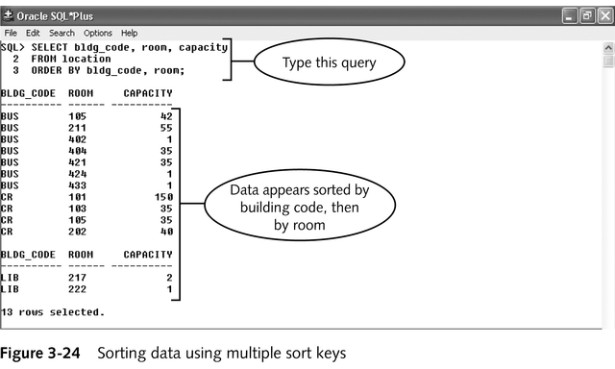
Sorting Query Output
Use ORDER BY sort_key_field(s)
Default order is ascending, use DESC to sort descending

Slide 6
Using Calculations in SQL Queries
Calculations are performed by DBMS, result only sent to client
Can use arithmetic operators (+, -, *, /)
Place calculation in select clause: SELECT price * quantity FROM …
Calculations can be performed on NUMBER, DATE and INTERVAL fields only
Single-row functions: built in Oracle functions to perform calculations and manipulate retrieved data values

Slide 7
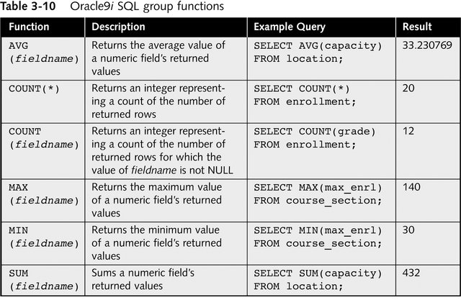
Oracle9i SQL Group Functions
Group functions: perform an operation on a group of queried rows and returns a single result

Slide 8
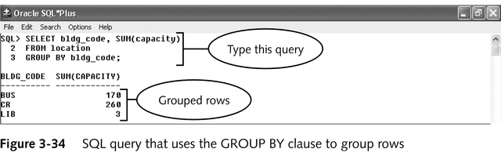
Group By
Use to group output by the field with duplicate values and apply group functions to the grouped data

Slide 9
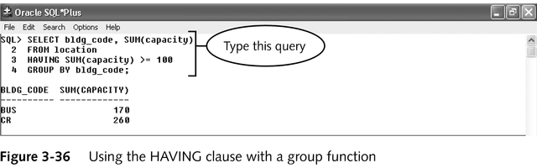
Having
Use to place a search condition on results of group function calculations
Like “WHERE” for group functions
HAVING group_function comparison_operator value
HAVING SUM(capacity) >= 100

Slide 10
Formatting Output in SQL*Plus
To change default column headings:
  Specify alternate column headings: SELECT fieldname1 "heading1_text", fieldname2 "heading2_text", ...
  Use an alias for column headings: SELECT fieldname1 AS alias_name1...
To change SQL*Plus line and page size settings
  Select Options/Environment on menu bar
  Modify linesize and pagesize to desired values

